Slide 1
MODULE LOG PARSER
By
Ruhi Shaik
Alekhya Saripella
Pahuljeet Kaur
Mary Gudise
Anwesha Anurakta

Slide 2
CONTENTS
Introduction
Software Resources
Input Log File
Validation of messages
Designing
UML Diagrams
Directory Structure

Slide 3
Introduction
Module log Parser displays the valid messages of the given module present in the input log file.
It performs validation on all the log messages of the module and differentiates between valid and invalid log messages.
It stores the identified invalid log messages in valid log file.
It stores the valid log messages according to the log message type.

Slide 4
Software Resources
C++
Linux
Valgrind
Cpp Unit
OOPs

Slide 5
Input Log File
The input log file contains valid and invalid logs.
The format for valid logs are as follows
<time seq><module name><log message type>E<4 digit error code><message>
Example :
1 command try FATAL E2004 is a leap year ;
If the format is not satisfied it is a invalid log message
Example :
20 algo WARNING e directory found
The log message types can be :
INFO, FATAL and WARNING

Slide 6
Validation Of Message
The validation is done on the basis of module name given.
If the module is correct and follows the format of input log file it is said to be a valid log message.
If not, the message will be invalid log message.
Example of valid log message
Module name : algo
14 algo WARNING E2001 directory is found

Slide 7
Example for invalid log message
Module name : algo
11 algo FATAL e directory not found
Module name : command try
16 command try INFO e 1120 is a directory

Slide 8
Designing
Multilevel Inheritance:
Derivation of a class from another derived class is called Multilevel Inheritance.
Class Message is the base class for the derived class Module, which in turn serves as a base class for the derived class Parser.
Class Module provides a link for the inheritance between message and parser and is known as an intermediate base class.
Standard Template Library[STL] : Multimap
Multimap is similar to a map with the addition that multiple elements can have the same keys.
These properties of multimap make it very much useful in competitive programming

Slide 9
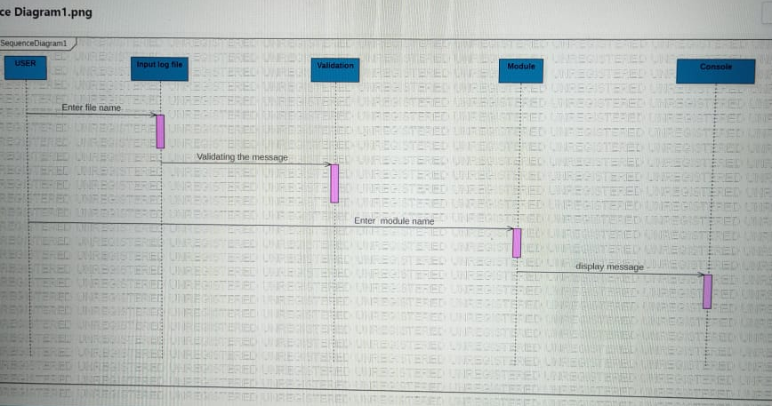
Sequence diagram

Slide 10
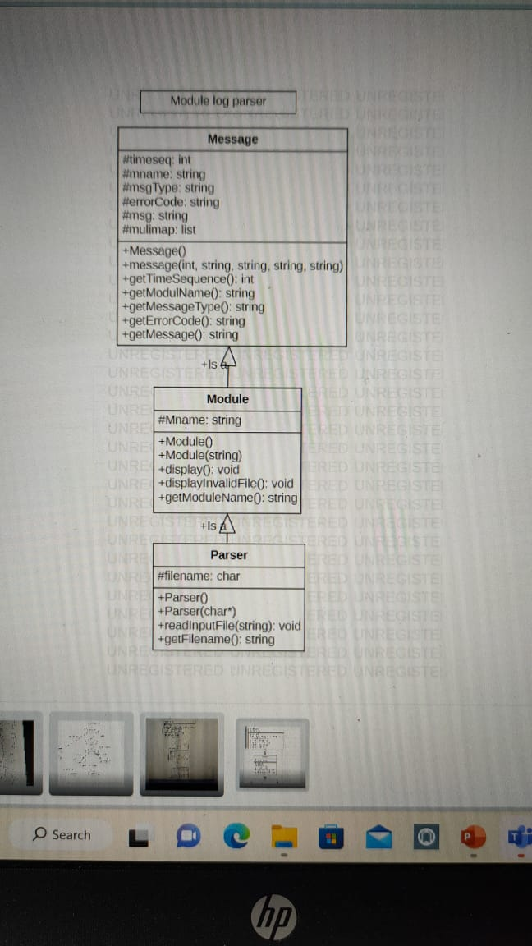
Class diagram

Slide 11
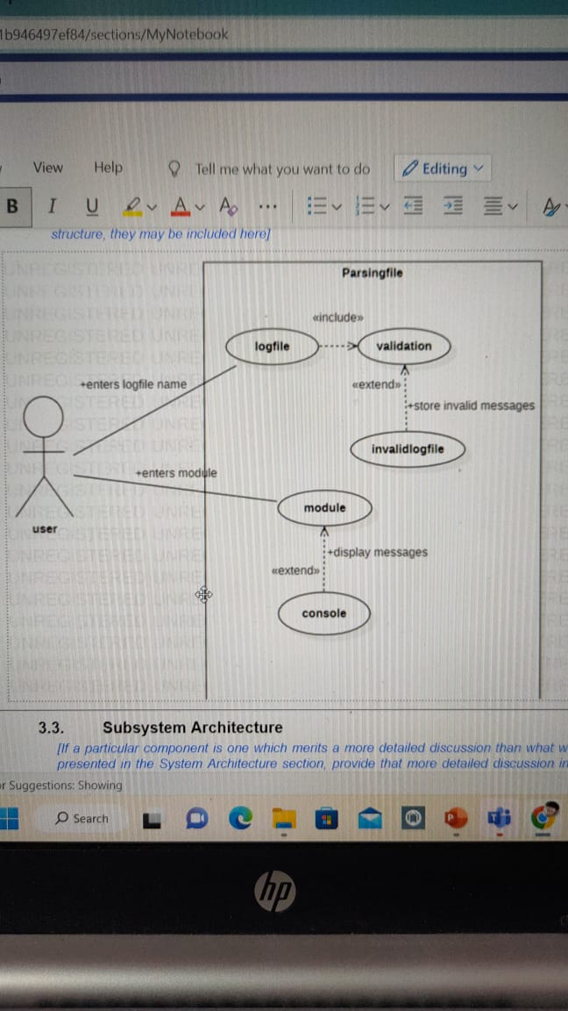
Use-Case diagram

Slide 12
Directory Structure
Src, include, bin, obj, make file, tools and cpp unit.
Include directory contains:
Message.h
Module.h
Parser.h
Src directory contains :
Message.cpp
Module.cpp
Parser.cpp

Slide 13
Makefile directory contains :
Makefile
Bin directory contains :
Tester executable file
Obj directory contains :
.o files
Tools directory contains :
Valgrind directory
Cppunit directory

Slide 14
Thank You

